Slide 1
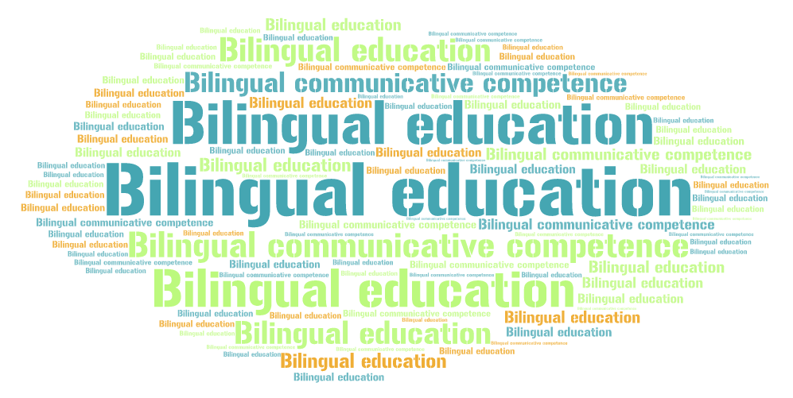

Slide 2
Economic, social, educational context
International integration (NES, BP, WTO)
IT (New Educational Standards)
Introduction of religious studies
English (Cambridge Standard)
Bilingualism/Trilingualism
Ecology Awareness
Health requirements
Notes:
The Bologna Process is a series of ministerial meetings and agreements between European countries designed to ensure comparability in the standards and quality of higher education qualifications. Through the Bologna Accords, the process has created the European Higher Education Area, in particular under the Lisbon Recognition Convention. It is named after the place it was proposed, the University of Bologna, with the signing in 1999 of the Bologna declaration by Education Ministers from 29 European countries. It was opened up to other countries signatory to the European Cultural Convention of the Council of Europe; further governmental meetings have been held in Prague (2001), Berlin (2003), Bergen (2005), London (2007), and Leuven (2009).
Before the signing of the Bologna declaration, the Magna Charta Universitatum had been issued at a meeting of university rectors celebrating the 900th anniversary of the University of Bologna – and thus of European universities – in 1988. One year before the Bologna declaration, education ministers Claude Allegre (France), Jürgen Rüttgers (Germany), Luigi Berlinguer (Italy) and Baroness Blackstone (UK) signed the Sorbonne declaration[1] in Paris 1998, committing themselves to "harmonising the architecture of the European Higher Education system".
It is a common misconception that the Bologna Process is an EU initiative. The Bologna Process currently has 47 participating countries,[2] whereas there are only 27 member states of the EU.[3] While the European Commission is an important contributor to the Bologna Process, the Lisbon Recognition Convention was actually prepared by the Council of Europe and members of the Europe Region of UNESCO.

Slide 3
Image of a graduate

Slide 4
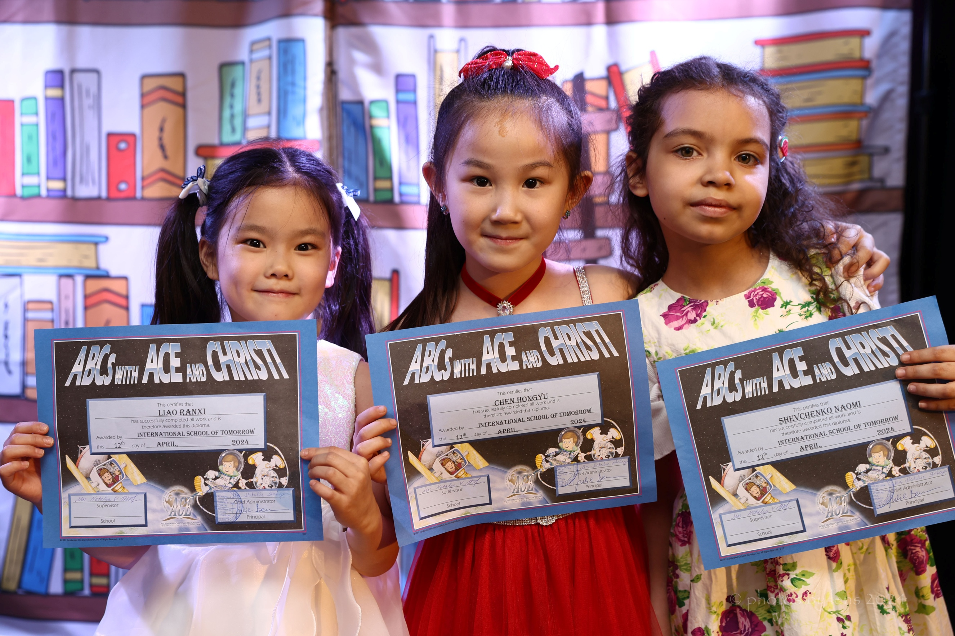
Image of a graduate

Slide 5
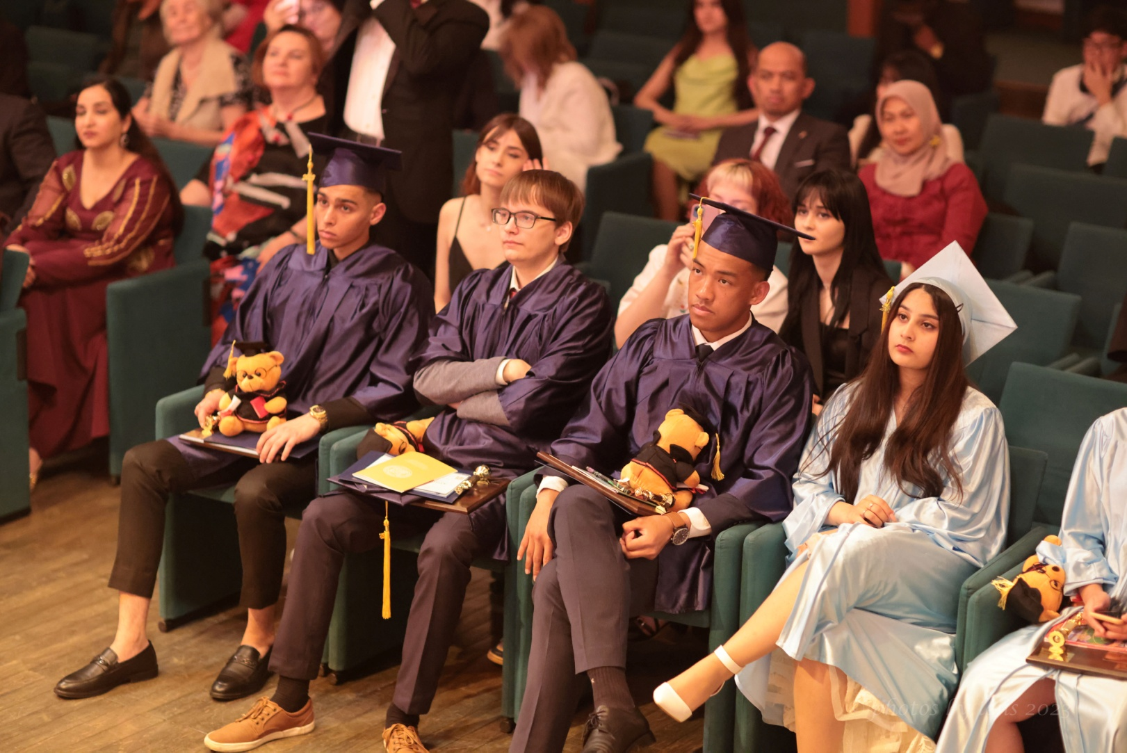
Image of a graduate:
Spiritual
Guided by God’s Word,
looking up to God for answers,
vision given by God
Values
respect for authority: parents, teachers,
believe in family values
Educational
Highly educated, well-versed,
leadership qualities,
bilingual/trilingual

Slide 6
Expected outcomes

Slide 7
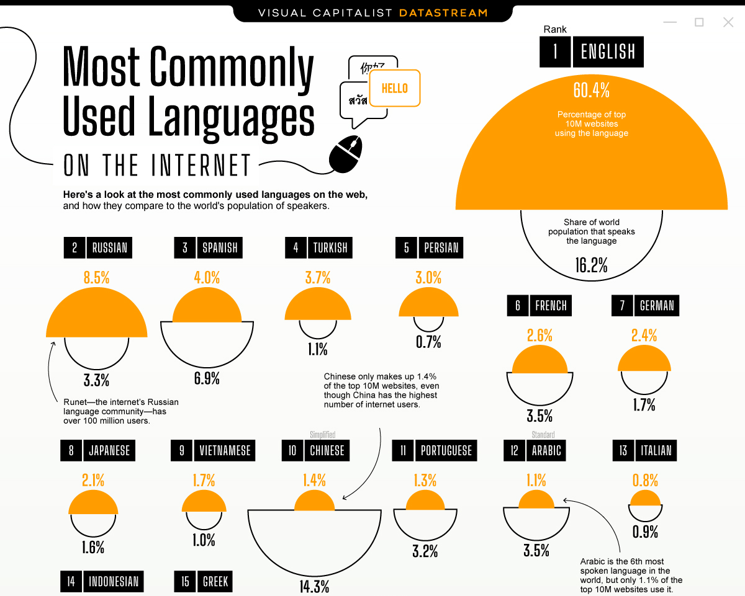
Expected
outcomes
Professional mobility

Slide 8
DEFINITION OF BILINGUALISM
Criteria (usage)
the ability to speak two languages
the frequent use (as by a community) of two languages
the political or institutional recognition of two languages

Slide 9
TYPE OF BILINGUALISM Criteria (acquisition/way of learning)
consecutive
simultaneous
receptive
Notes:
Questions:
Anecdote: A person speaking three languages is a trilingual person, speaking two – bilingual, one – American.
Who speaks one language? Who speaks two languages? Who speaks three languages?

Slide 10
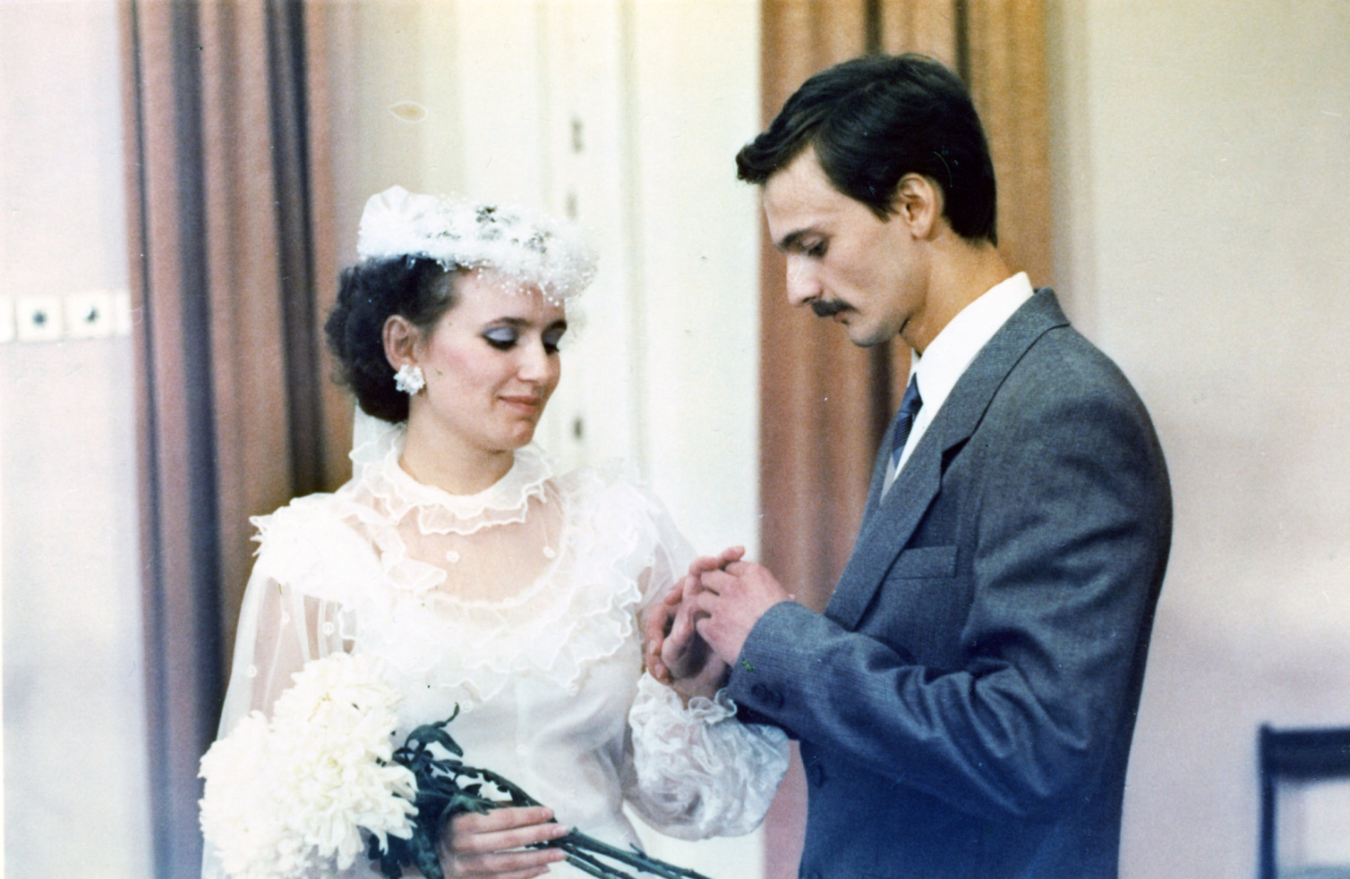
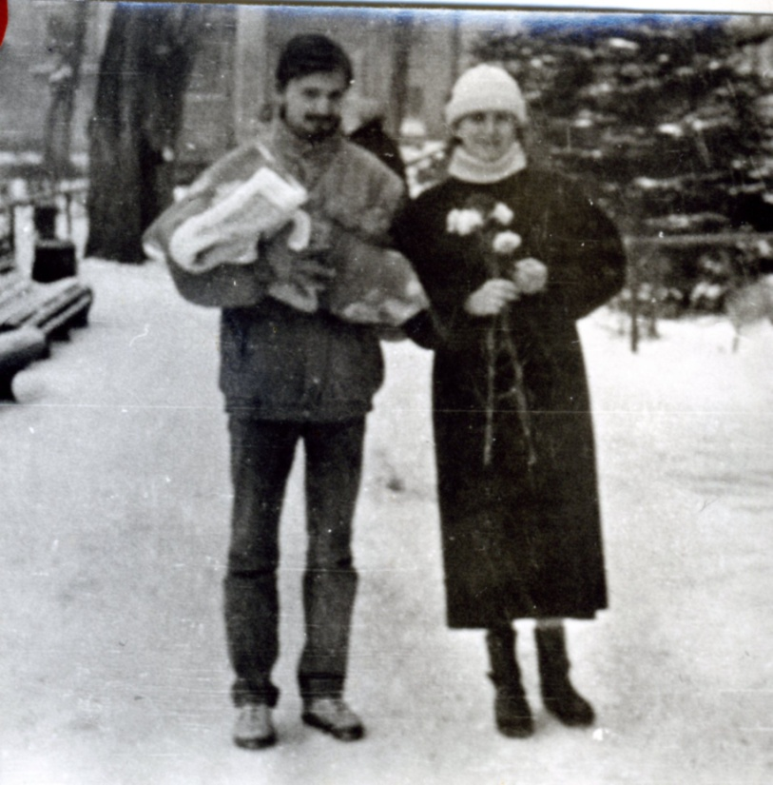
English
Русский
English

Slide 11
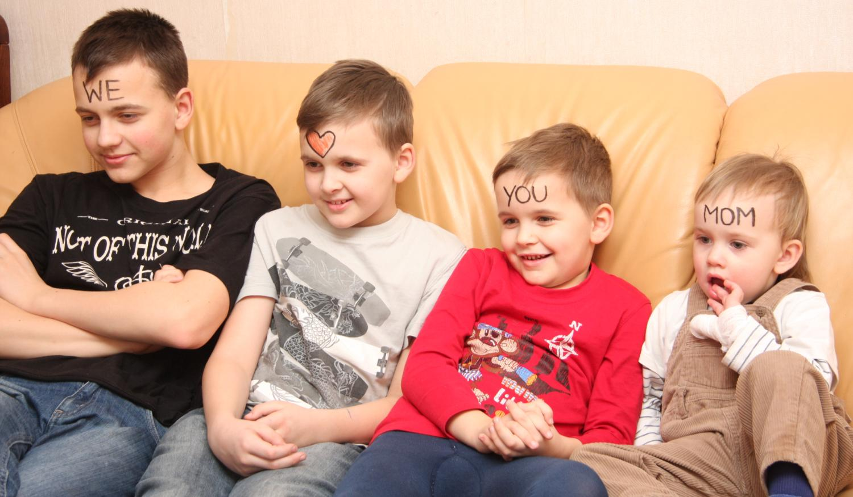
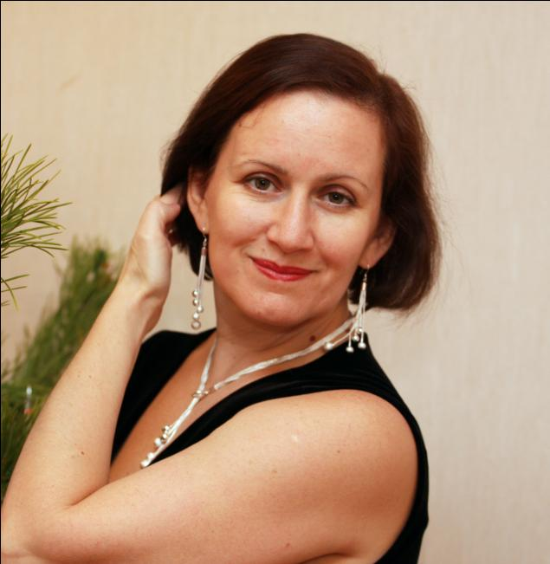
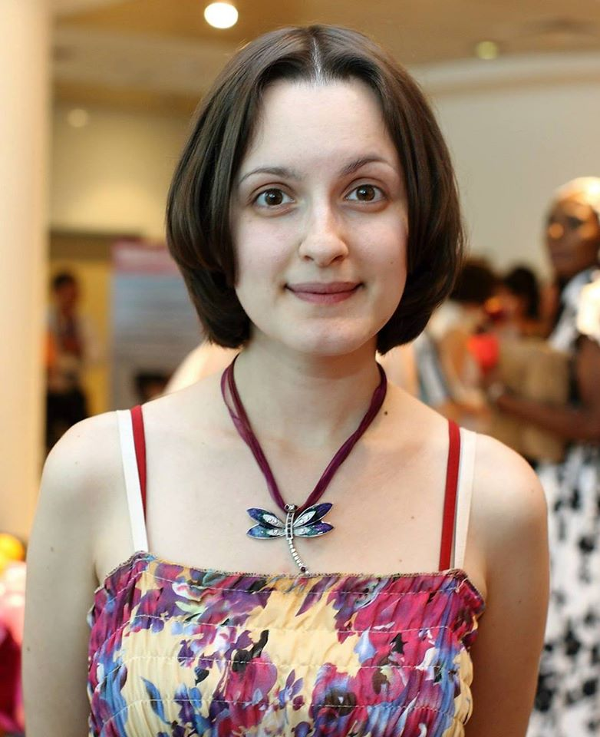
1990 - 2014

Slide 12
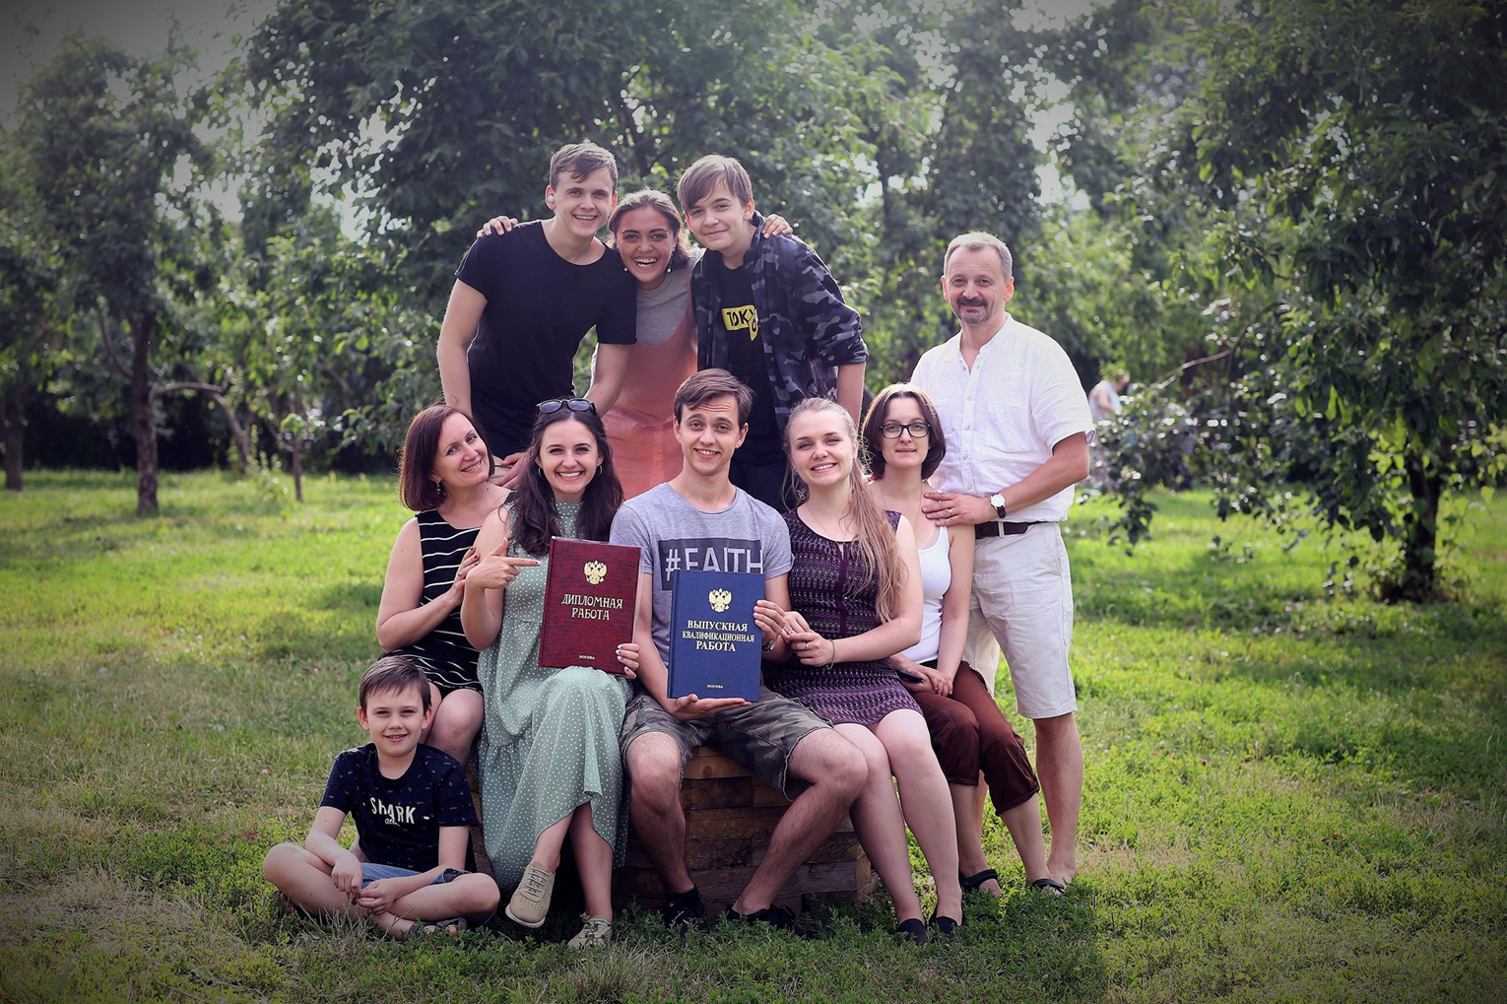

Slide 13
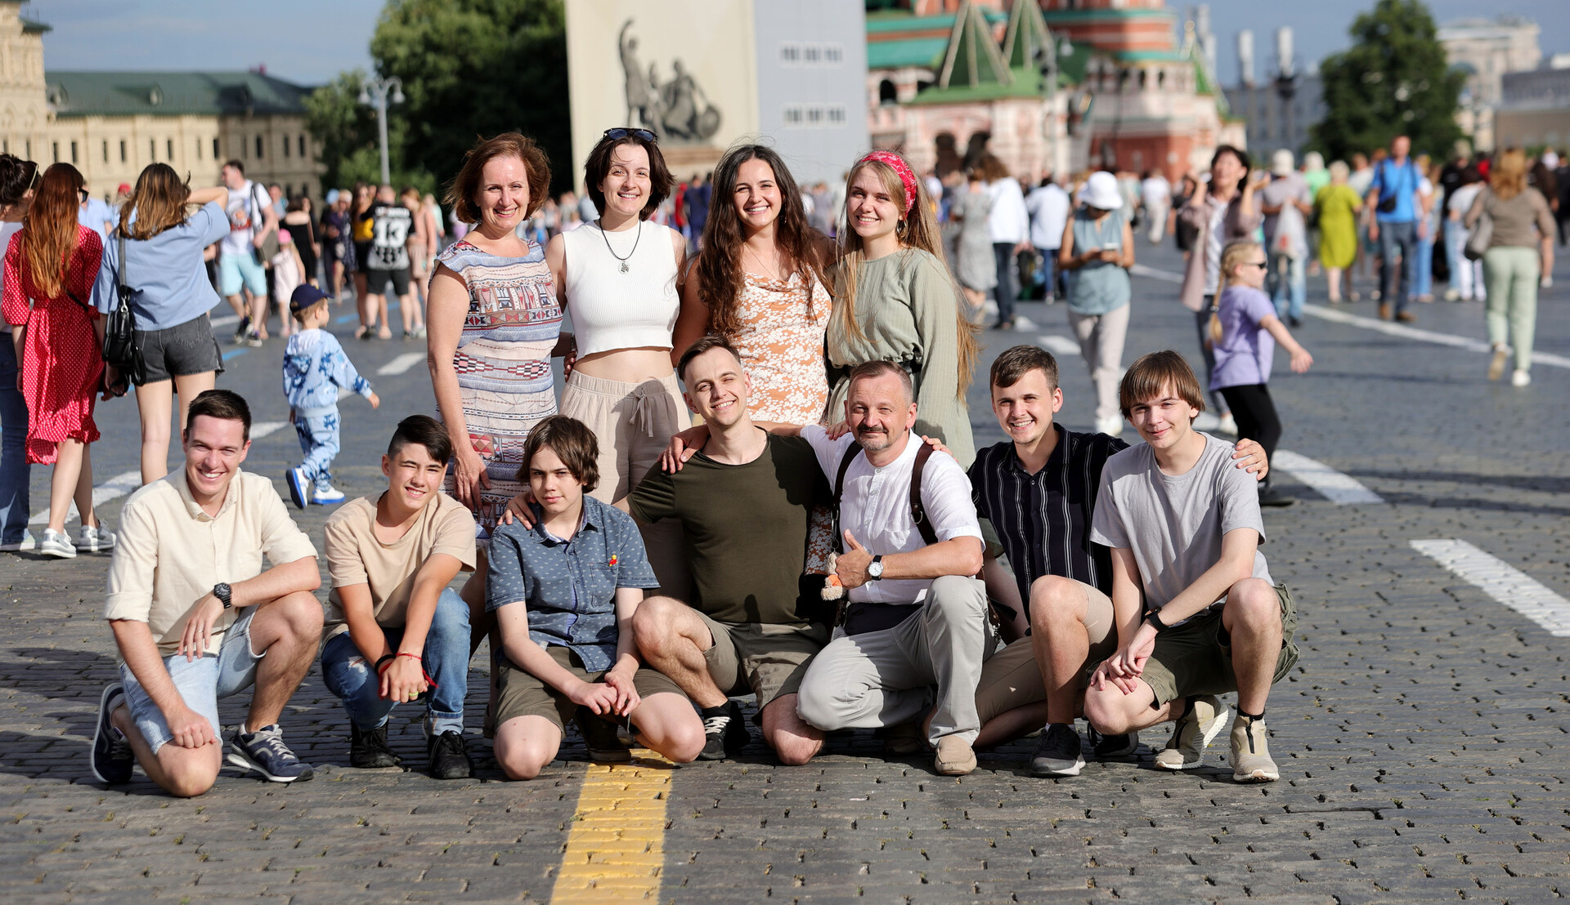

Slide 15
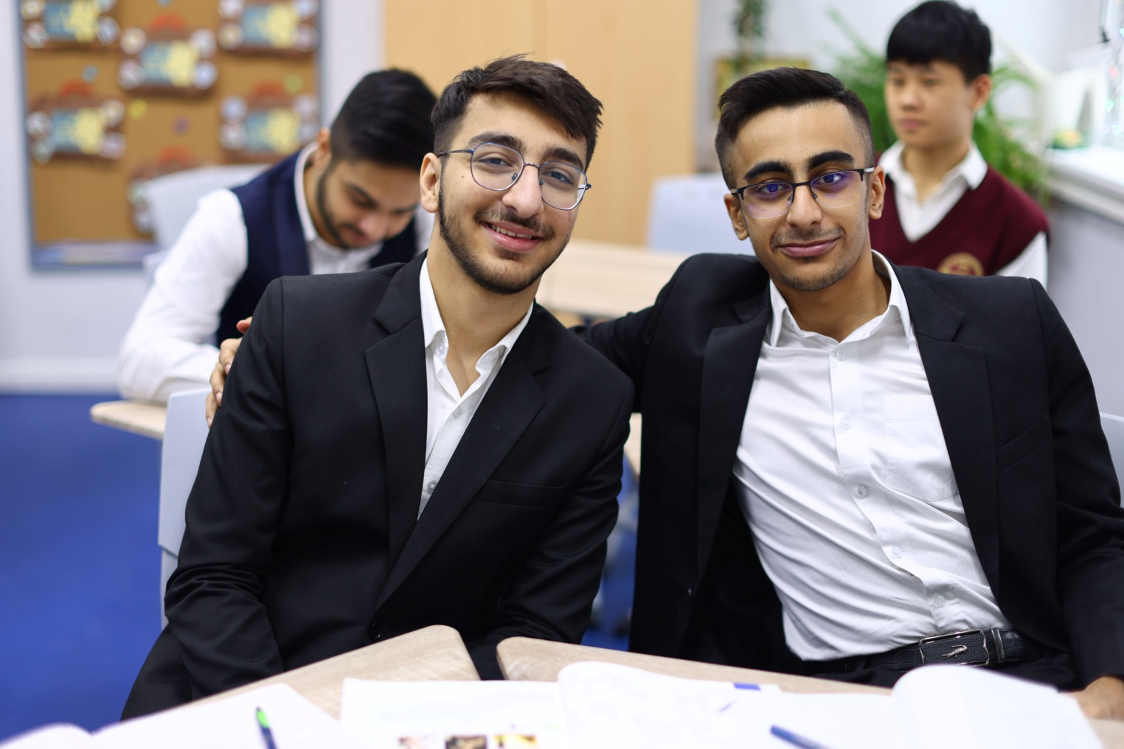
Approaches in Bilingual education
Criteria (method of teaching)
Immersion / Погружение
Transition / Переход
Development / Развитие

Slide 16
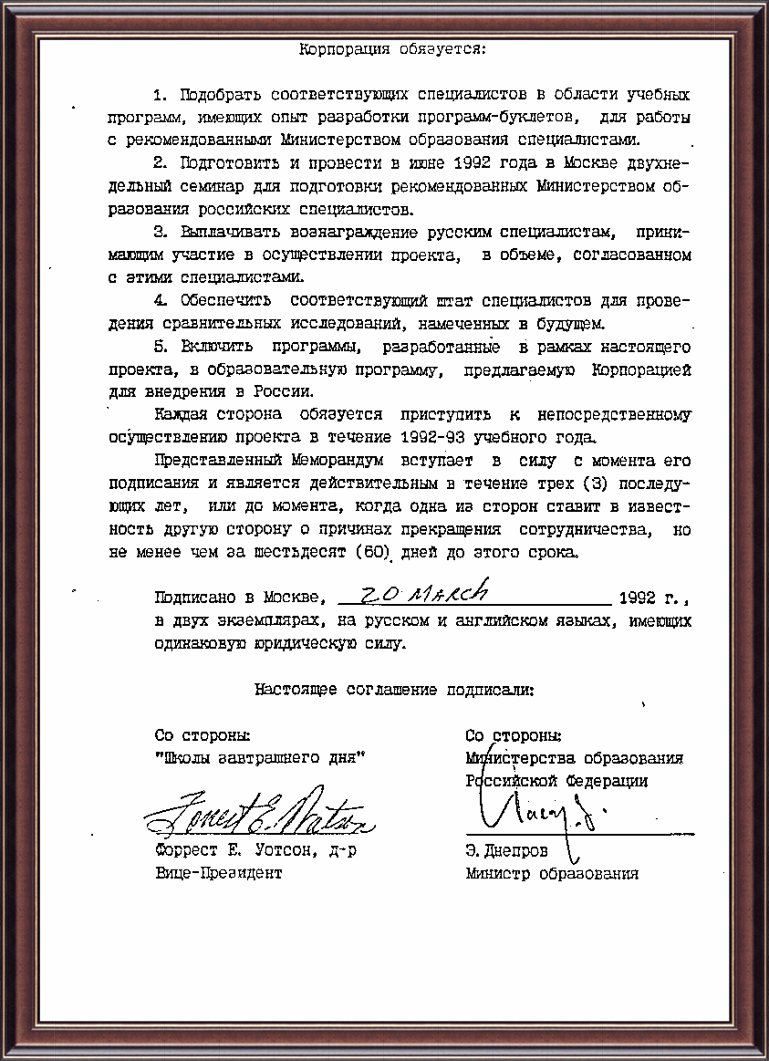
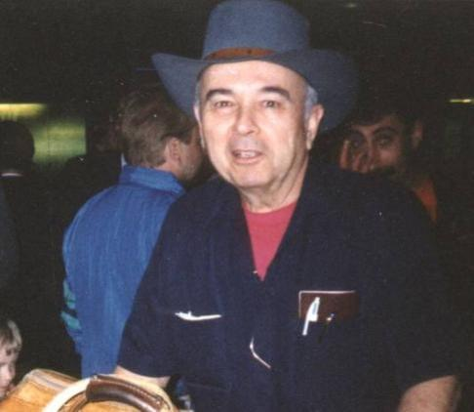
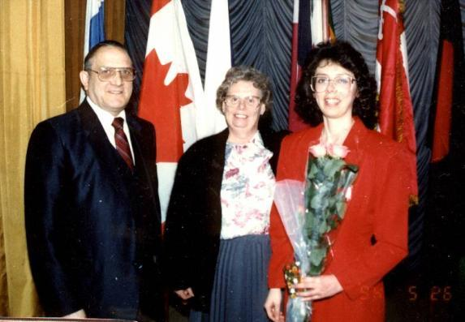
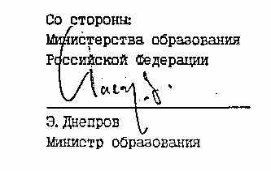
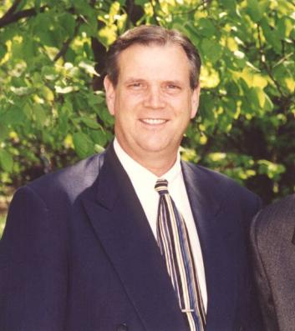
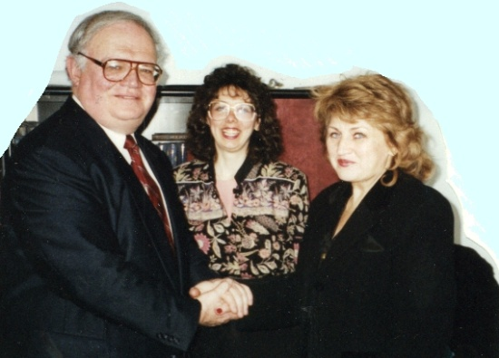
1992
Меморандум о взаимопонимании

Slide 17
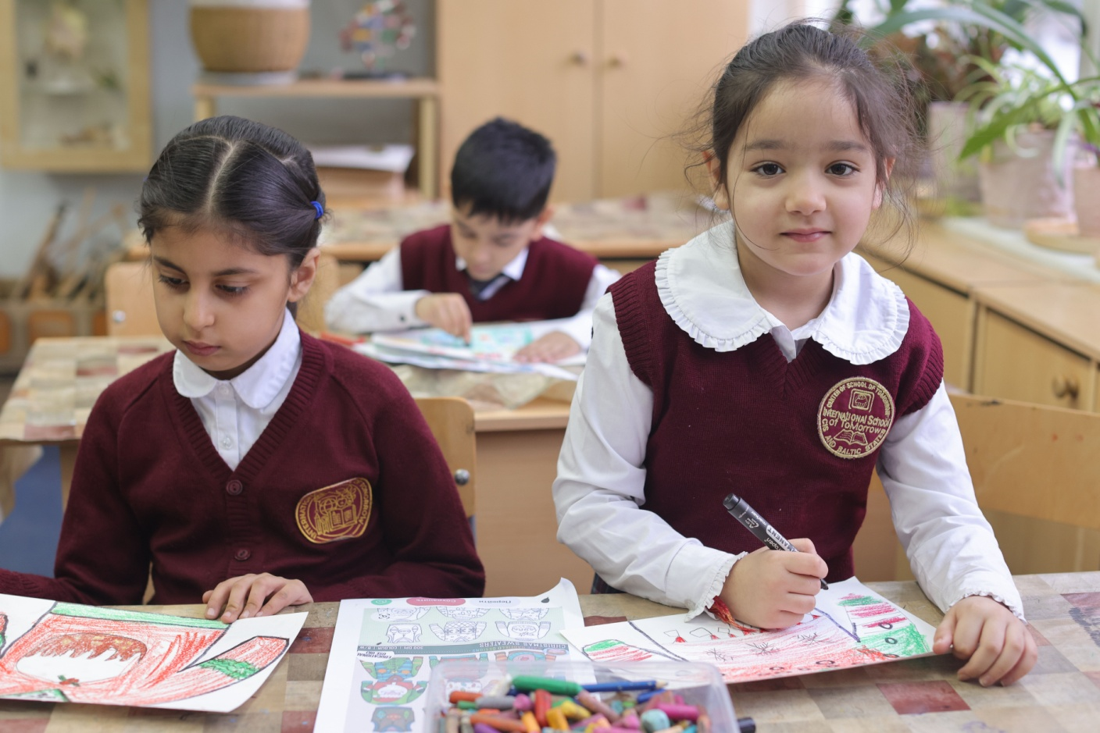
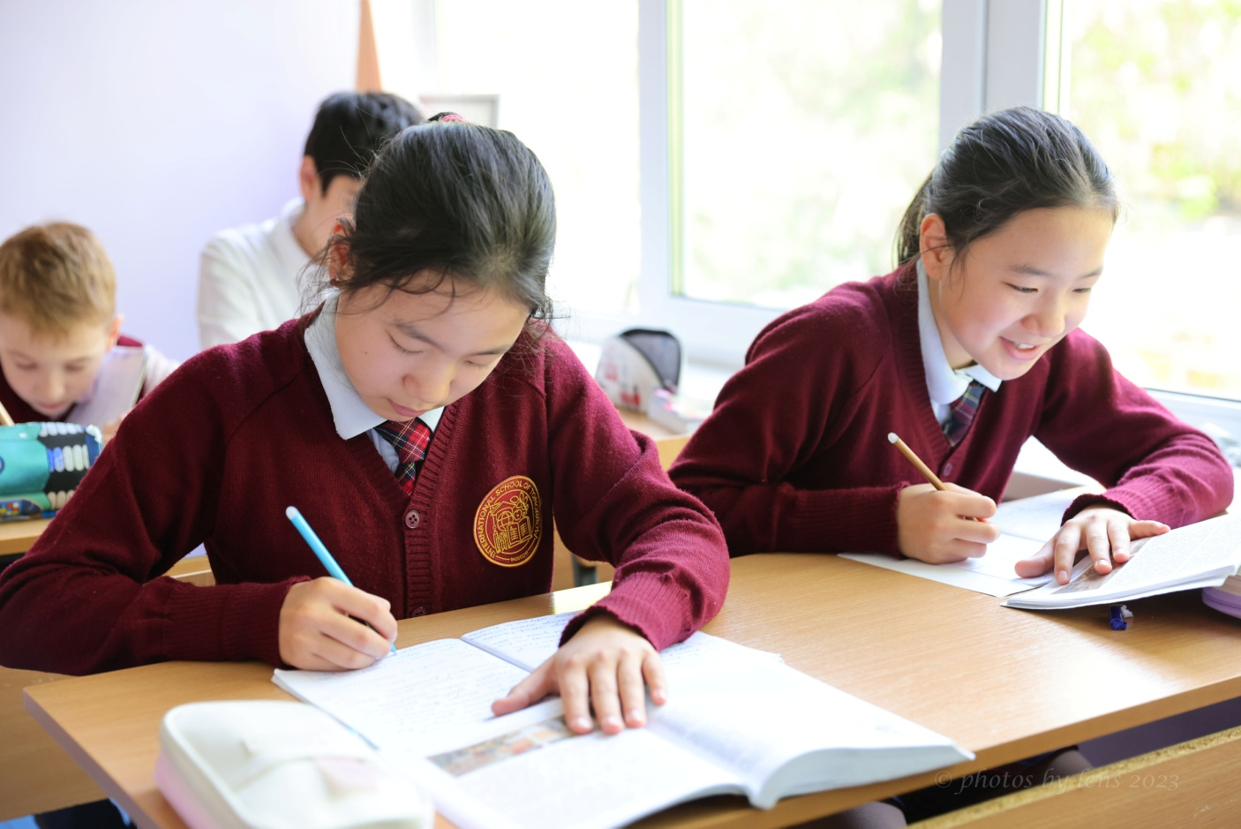
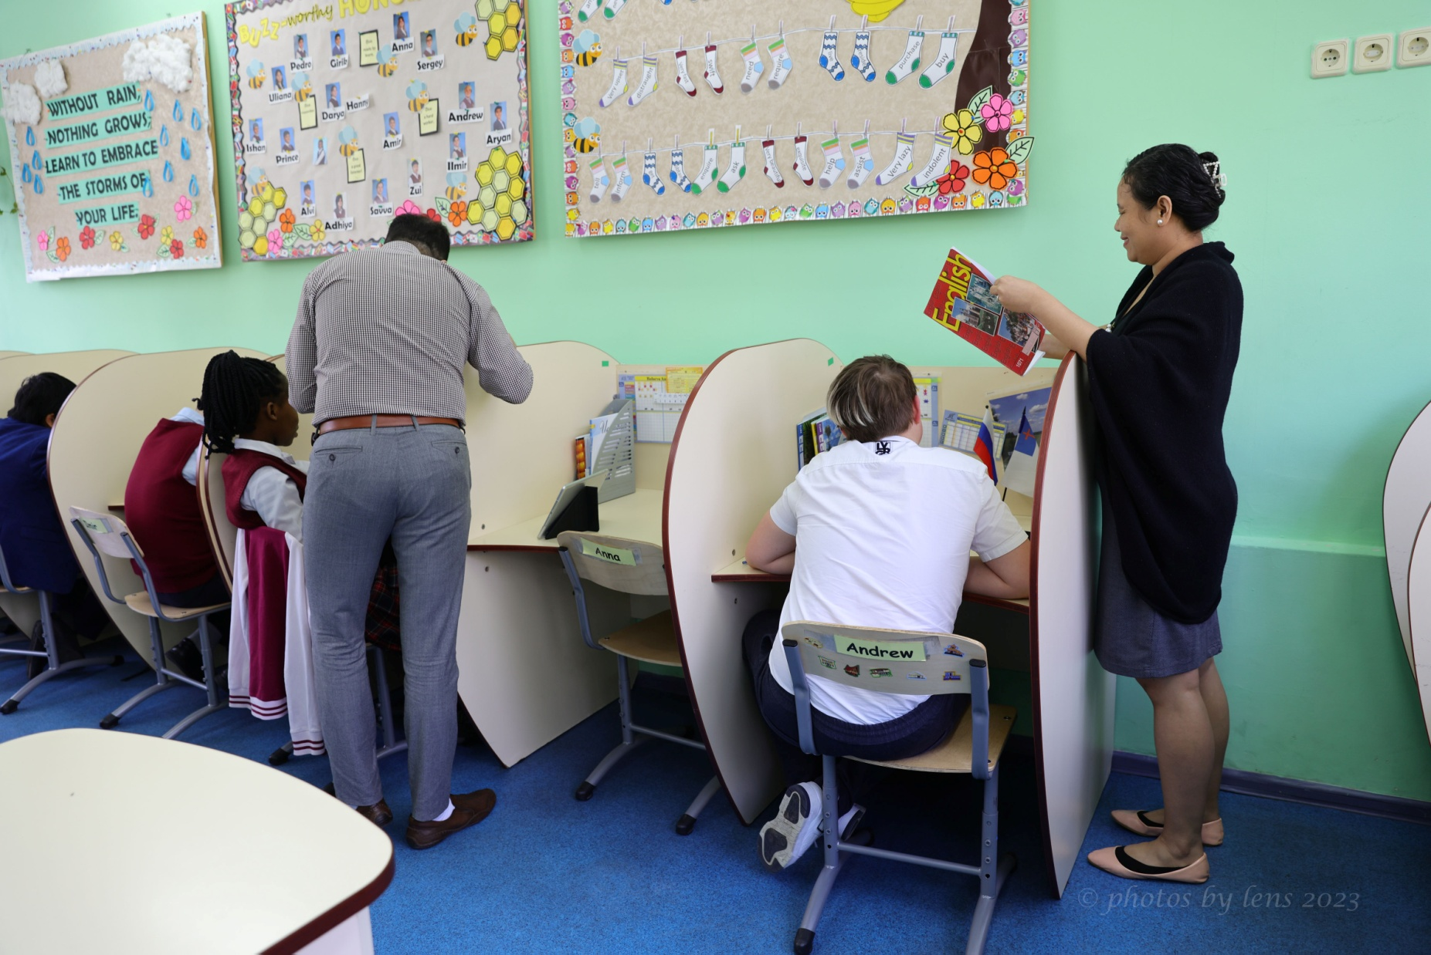
School of Tomorrow + National
programs
”Render to Caesar what is
Caesar's and to God what is God’s.”
Mark 12:17

Slide 18
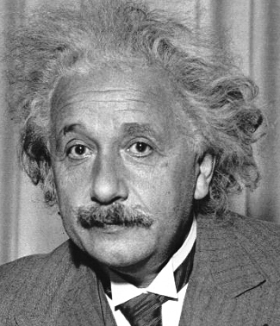
“Problems cannot be solved by the same level of thinking that created them.” A. Einstein

Slide 19
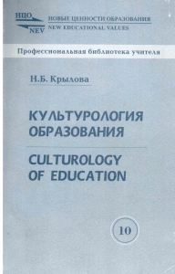
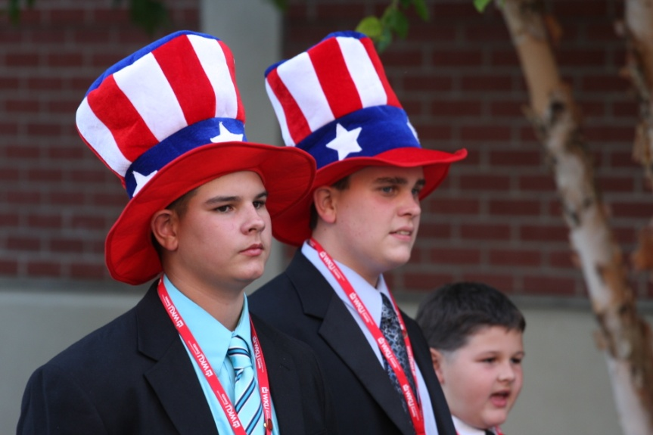
The culturological approach
The culturological approach presupposes “a total of methodological procedures which facilitate the analysis of any sphere of human life and human activity in terms of the core concepts of culturology, e.g. culture, cultural patterns, norms and values, socio-economic setup and life patterns, the individual and society, cultural activity and interests.”
(N.B. Krylova. Culturology of Education. М.:/Народной образование, 2000, p.65)

Slide 20
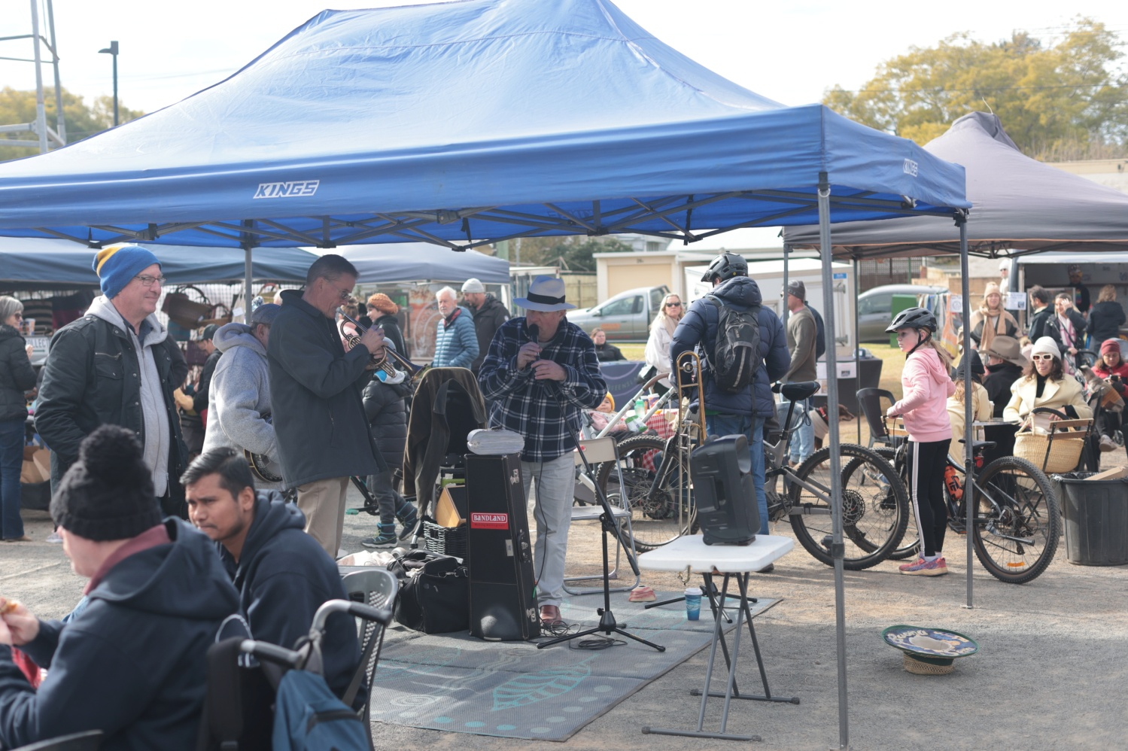
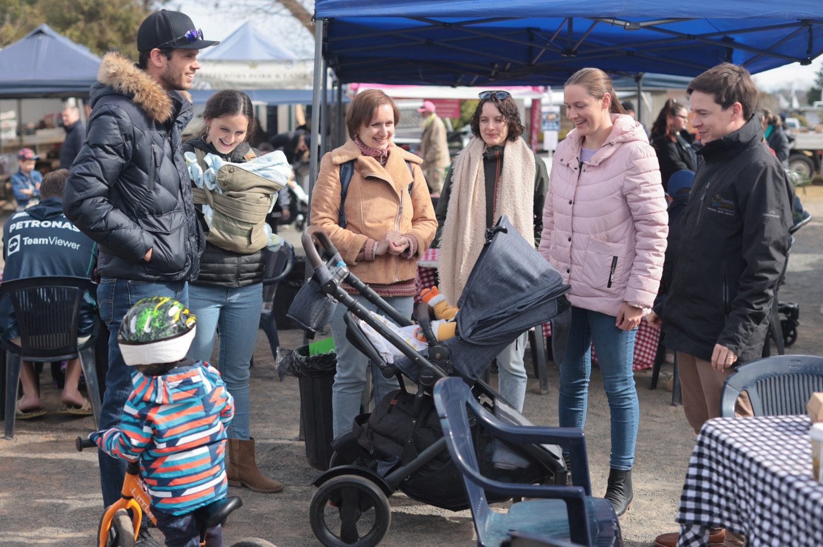
Components of the CA
Learning a language not…as a separate field…of knowledge, but…as one of the interdependent elements of…culture.
Not only understanding…a culture, but also immersing oneself in it.
Learning cultural patterns (including language) and facilitating an individual’s immersion into the semantic contexts of…culture.

Slide 21
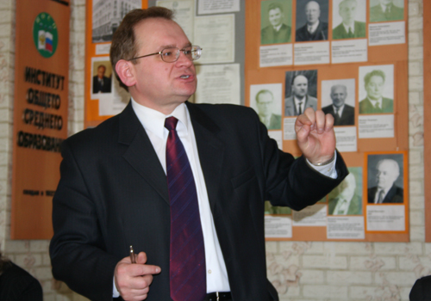
Communicative competence
Communicative competence is the knowledge of the languages and means of interpersonal and long-distance communication, teamwork skills and a command of various social roles within a team.
A.V. Khutorskoy

Slide 22
Виды универсальных учебных действий Universal action based educational competencies
Личностные (Personal)
Регулятивные (Regulatory)
Общепознавательные (Cognitive)
Коммуникативные (Communicative)
Bilingual

Slide 23
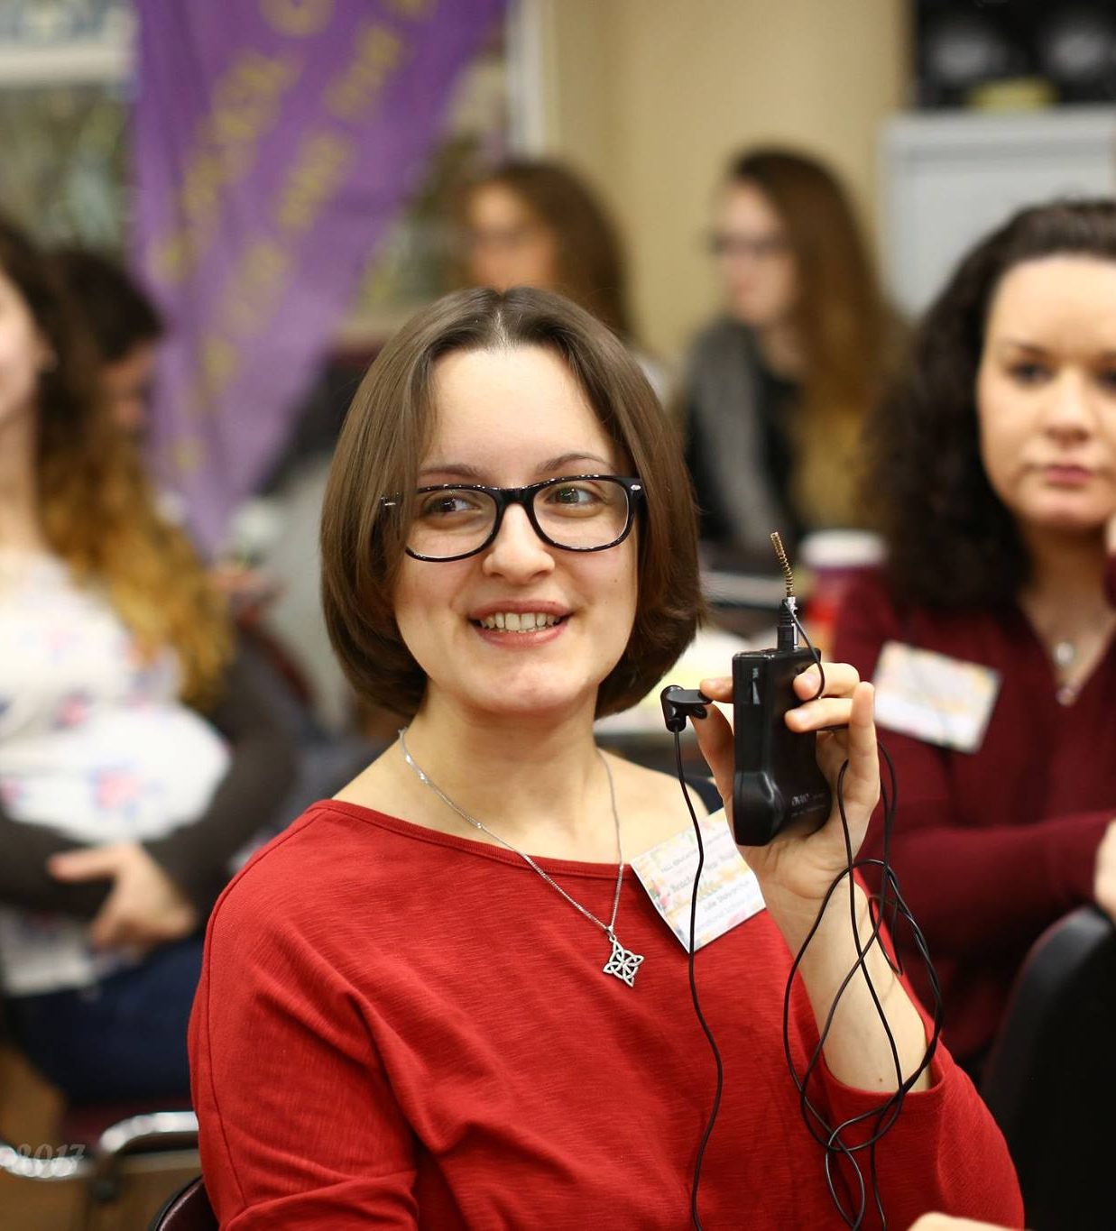
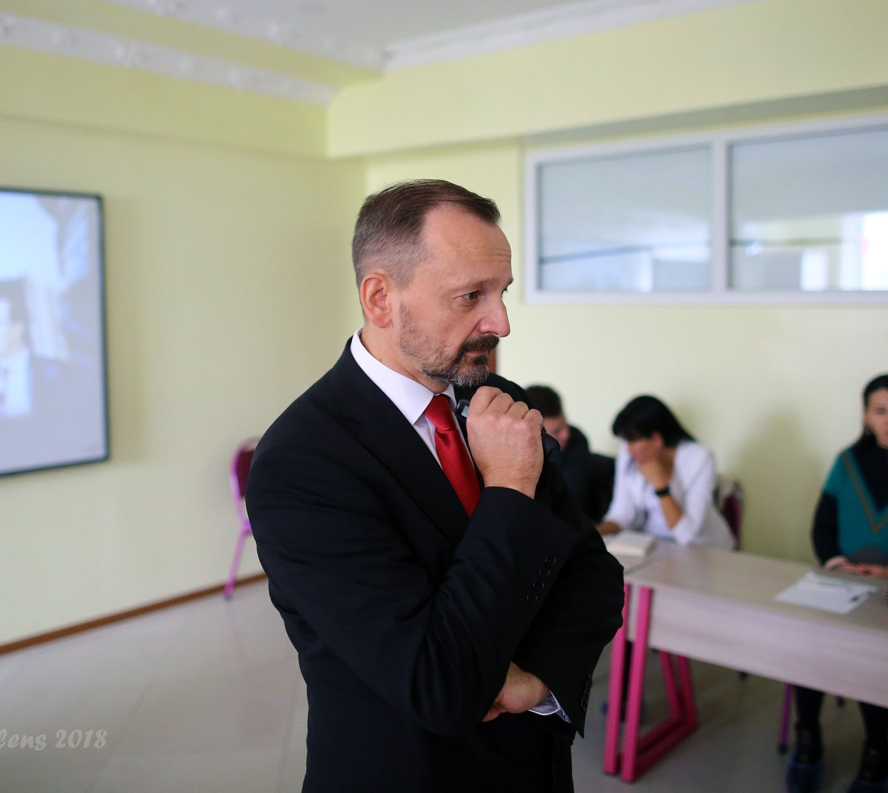
CLIL stands for Content and Language Integrated Learning and refers to teaching subjects such as science, history and geography to students through a foreign language.
ИНТЕГРИРОВАННЫЙ
ПРЕДМЕТНО-ЯЗЫКОВОЙ ПОДХОД
(CLIL)

Slide 24
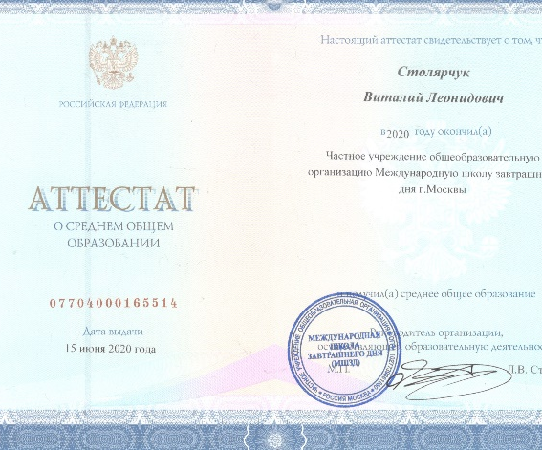
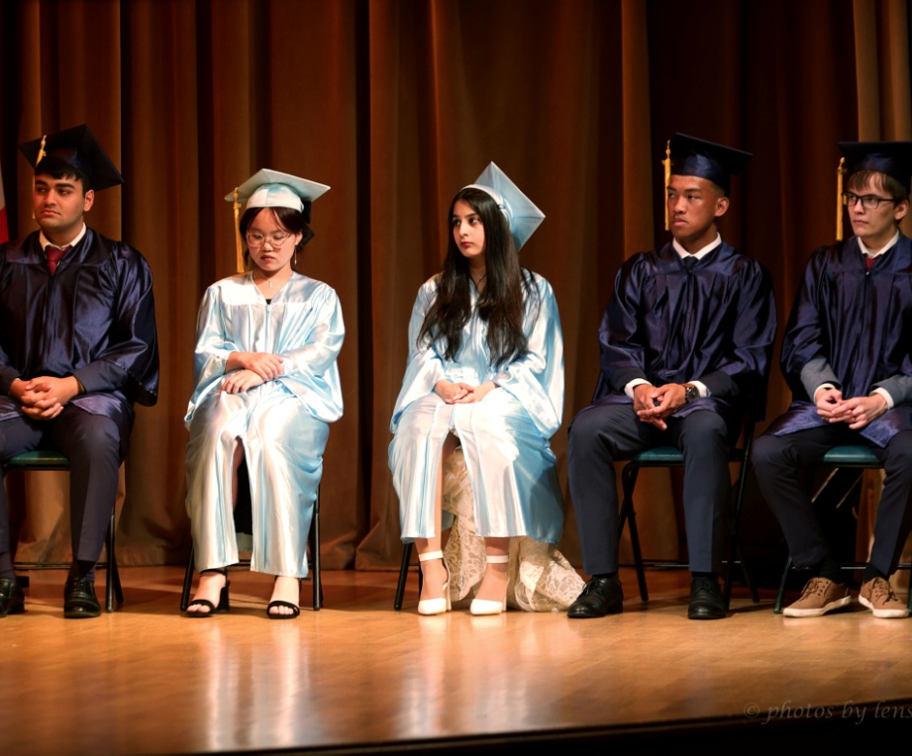

Slide 25
“Problems cannot be solved by the same level of thinking that created them.” A. Einstein

Slide 26
God bless you!

